Slide 1
Attention Via Convolutional Nearest Neighbors
Mingi Kang Bowdoin 2026
Jeová Farias Sales Rocha Neto
Senior Honors Presentation
Mingi Kang mkang2@bowdoin.edu

Slide 2

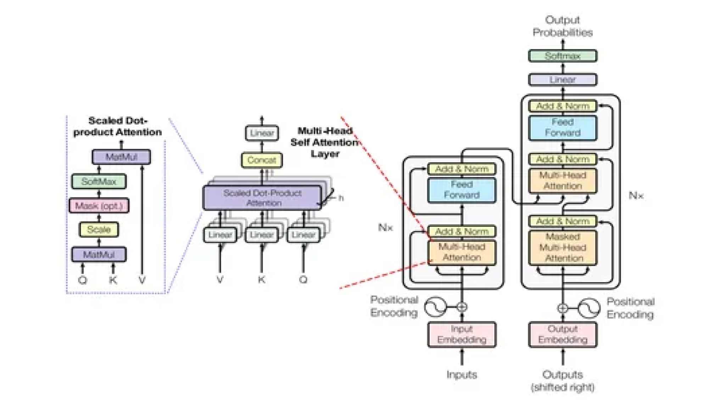
Motivation
CNNs and Transformers are the most used architectures across vision and language tasks.
But, how do their core operations: convolution and self attention, relate to each other?
Convolutional Neural Network (CNN)
Transformer Architecture
https://developersbreach.com/convolution-neural-network-deep-learning/ https://www.analyticsvidhya.com/blog/2024/04/understanding-transformers-a-deep-dive-into-nlps-core-technology/

Slide 3
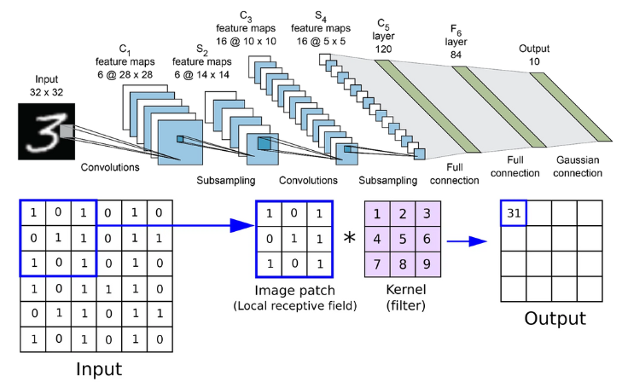
Convolution
Convolutions captures local spatial structure by design.
Kernels slide across the input, learning patterns within a fixed neighborhood of pixels.
This spatial locality bias makes convolution powerful for images, videos, and other data with strong local correlations.
https://www.superannotate.com/blog/guide-to-convolutional-neural-networks

Slide 4
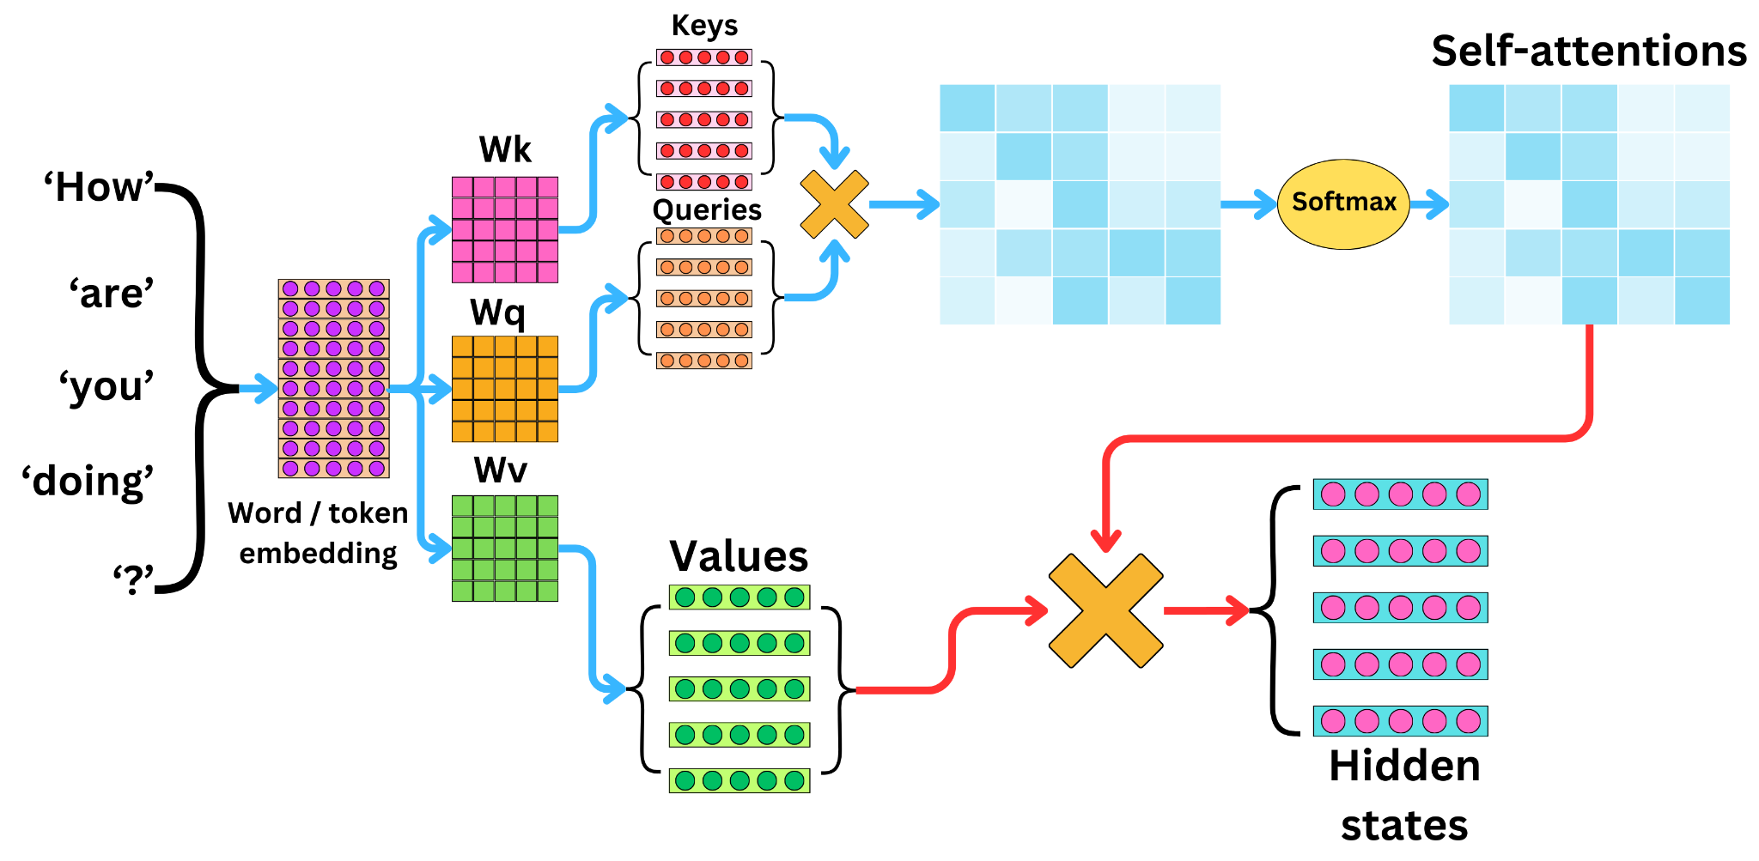
Self-Attention
Self-Attention (Vaswani et al. 2017) transforms inputs into Query (Q), Key (K), and Value (V).
Attention Weights determines which positions to attend to based on learned feature similarity.
This enables global receptive fields where each token can aggregate information from any other position.
https://newsletter.theaiedge.io/p/understanding-the-self-attention

Slide 5
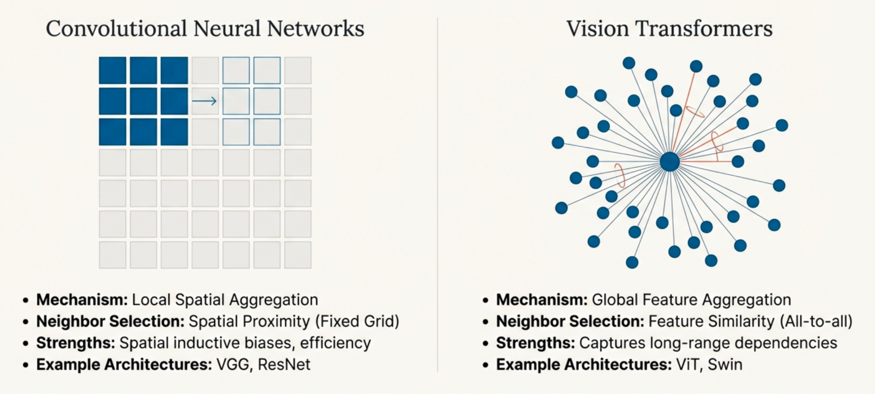
CNNs vs. Vision Transformers

Slide 6
Convolutional Nearest Neighbor
(ConvNN)
Unified Framework that formalizes the connection between convolution and attention through the k-nearest neighbors principle from machine learning.
Mingi Kang mkang2@bowdoin.edu

Slide 7
ConvNN Framework
01
02
03
Similarity Computation
Neighbor Selection
Weighted Aggregation
How do we measure similarity between pixels (features)?
Similarity Metrics:
Cosine Similarity
Euclidean distance
Dot product
Operation:
Convolution: Spatial proximity
Attention: Feature similarity
How do we identify the most relevant neighbors?
Selection Process:
Compute S = XX^T
k-max: top-k scores
k-argmax: top-k indices
Result: k neighbors per pixel across all positions.
How do we aggregate information from selected neighbors?
Aggregation Options:
Standard Convolution
Depthwise Convolution
Depthwise-Separable Convolution
Applied to concatenated neighborhood matrices
(stride = k, kernel = k)
Mingi Kang mkang2@bowdoin.edu

Slide 8
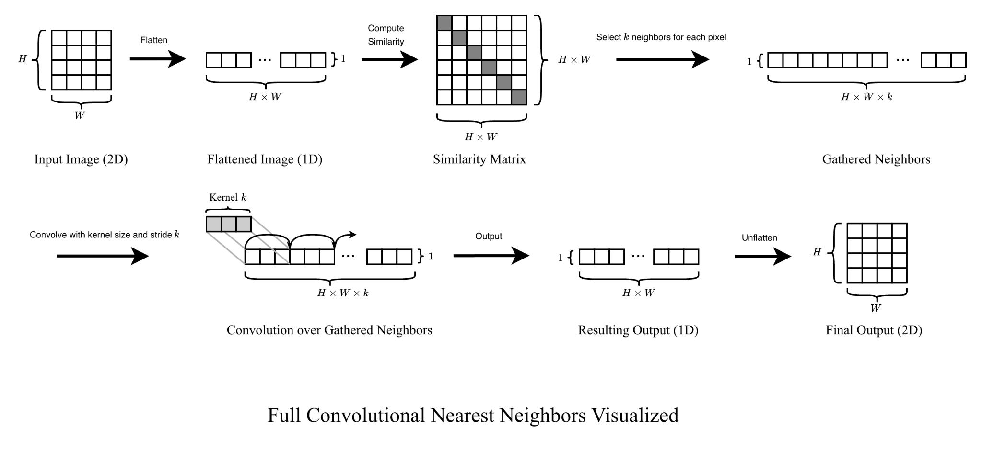
ConvNN Visualized
*Channel dimensions are omitted in diagram for visual clarity.
Mingi Kang mkang2@bowdoin.edu

Slide 9
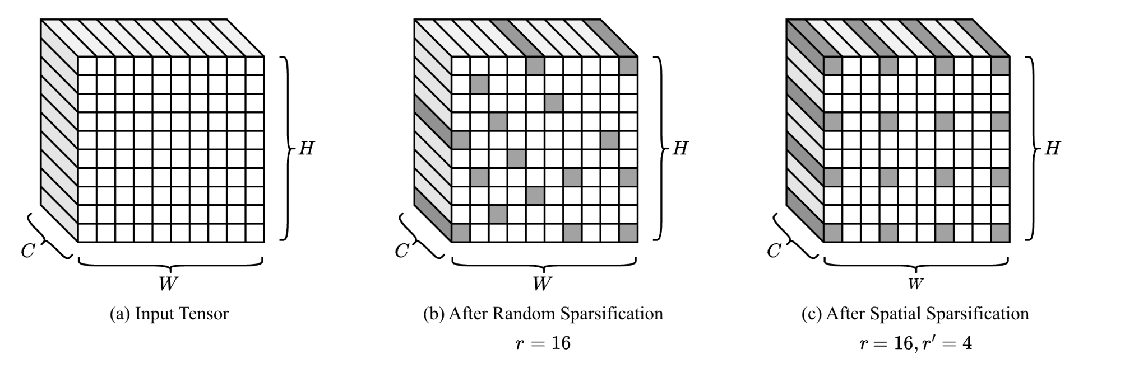

Sparse Neighbor Search
k-NN search complexity:
Mingi Kang mkang2@bowdoin.edu

Slide 10





Generalization of Convolution
Traditional Convolution
ConvNN
Mingi Kang mkang2@bowdoin.edu
Notes:
Remove slide, just explain shortly

Slide 11




Generalization of Attention
ConvNN-Attention
Self-Attention
Mingi Kang mkang2@bowdoin.edu
Notes:
Remove slide, just explain shortly

Slide 12
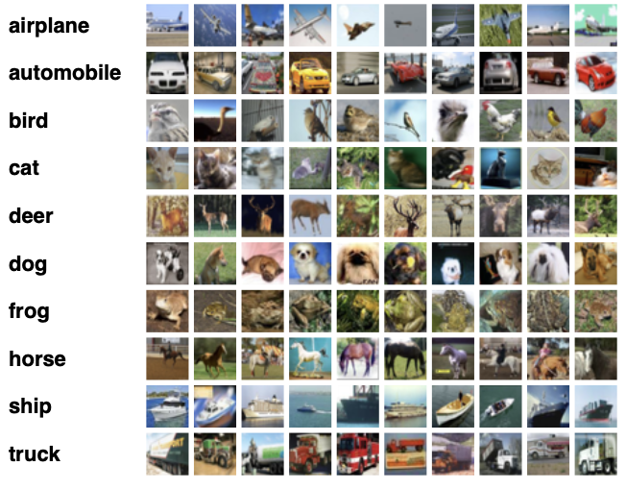
Experiments
Datasets: CIFAR-10 and CIFAR-100 (Krizhevsky et al., 2009)
60,000 images (32x32 RGB)
10 classes (CIFAR-10) / 100 classes (CIFAR-100)
Train/test split: 50,000 / 10,000
No data augmentation to ensure fair baseline comparison
Architectures:
VGG-11: Convolutional Baseline (32x32 RGB)
ViT-Tiny: Transformer Baseline (224x224 RGB)
https://www.cs.toronto.edu/~kriz/cifar.html
Notes:
Remove slide, just explain shortly

Slide 13
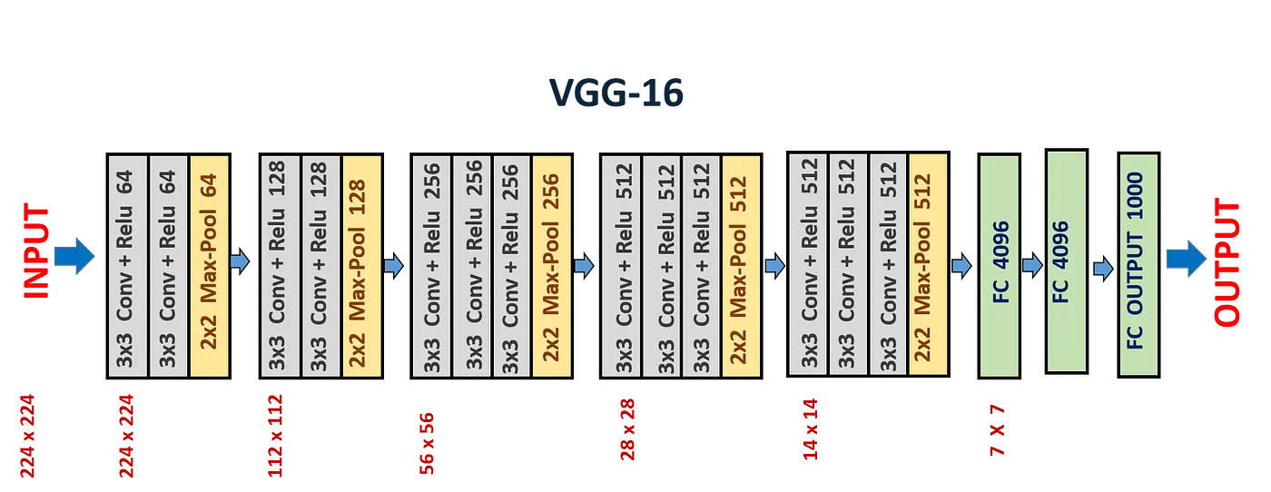
VGG Architecture
VGG-11 Architecture (Simonyan & Zisserman, 2015)
Standard Architecture:
Stacked convolutional layers with ReLU activation
Max pooling for spatial downsampling
Fully connected layers for classification
Our Modification:
Replace standard Conv2D layers with ConvNN or Hybrid Branching
*Diagram is VGG-16 instead of VGG-11
https://medium.com/@siddheshb008/vgg-net-architecture-explained-71179310050f

Slide 14
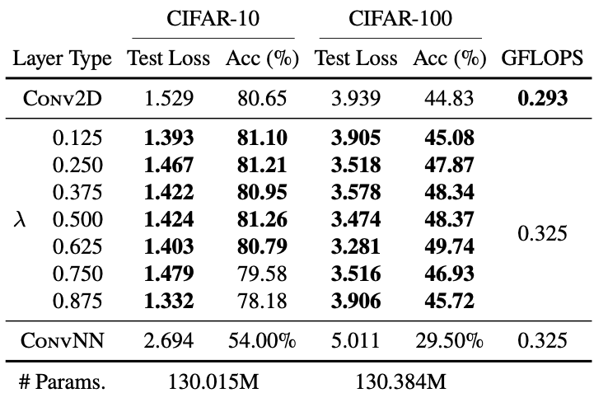
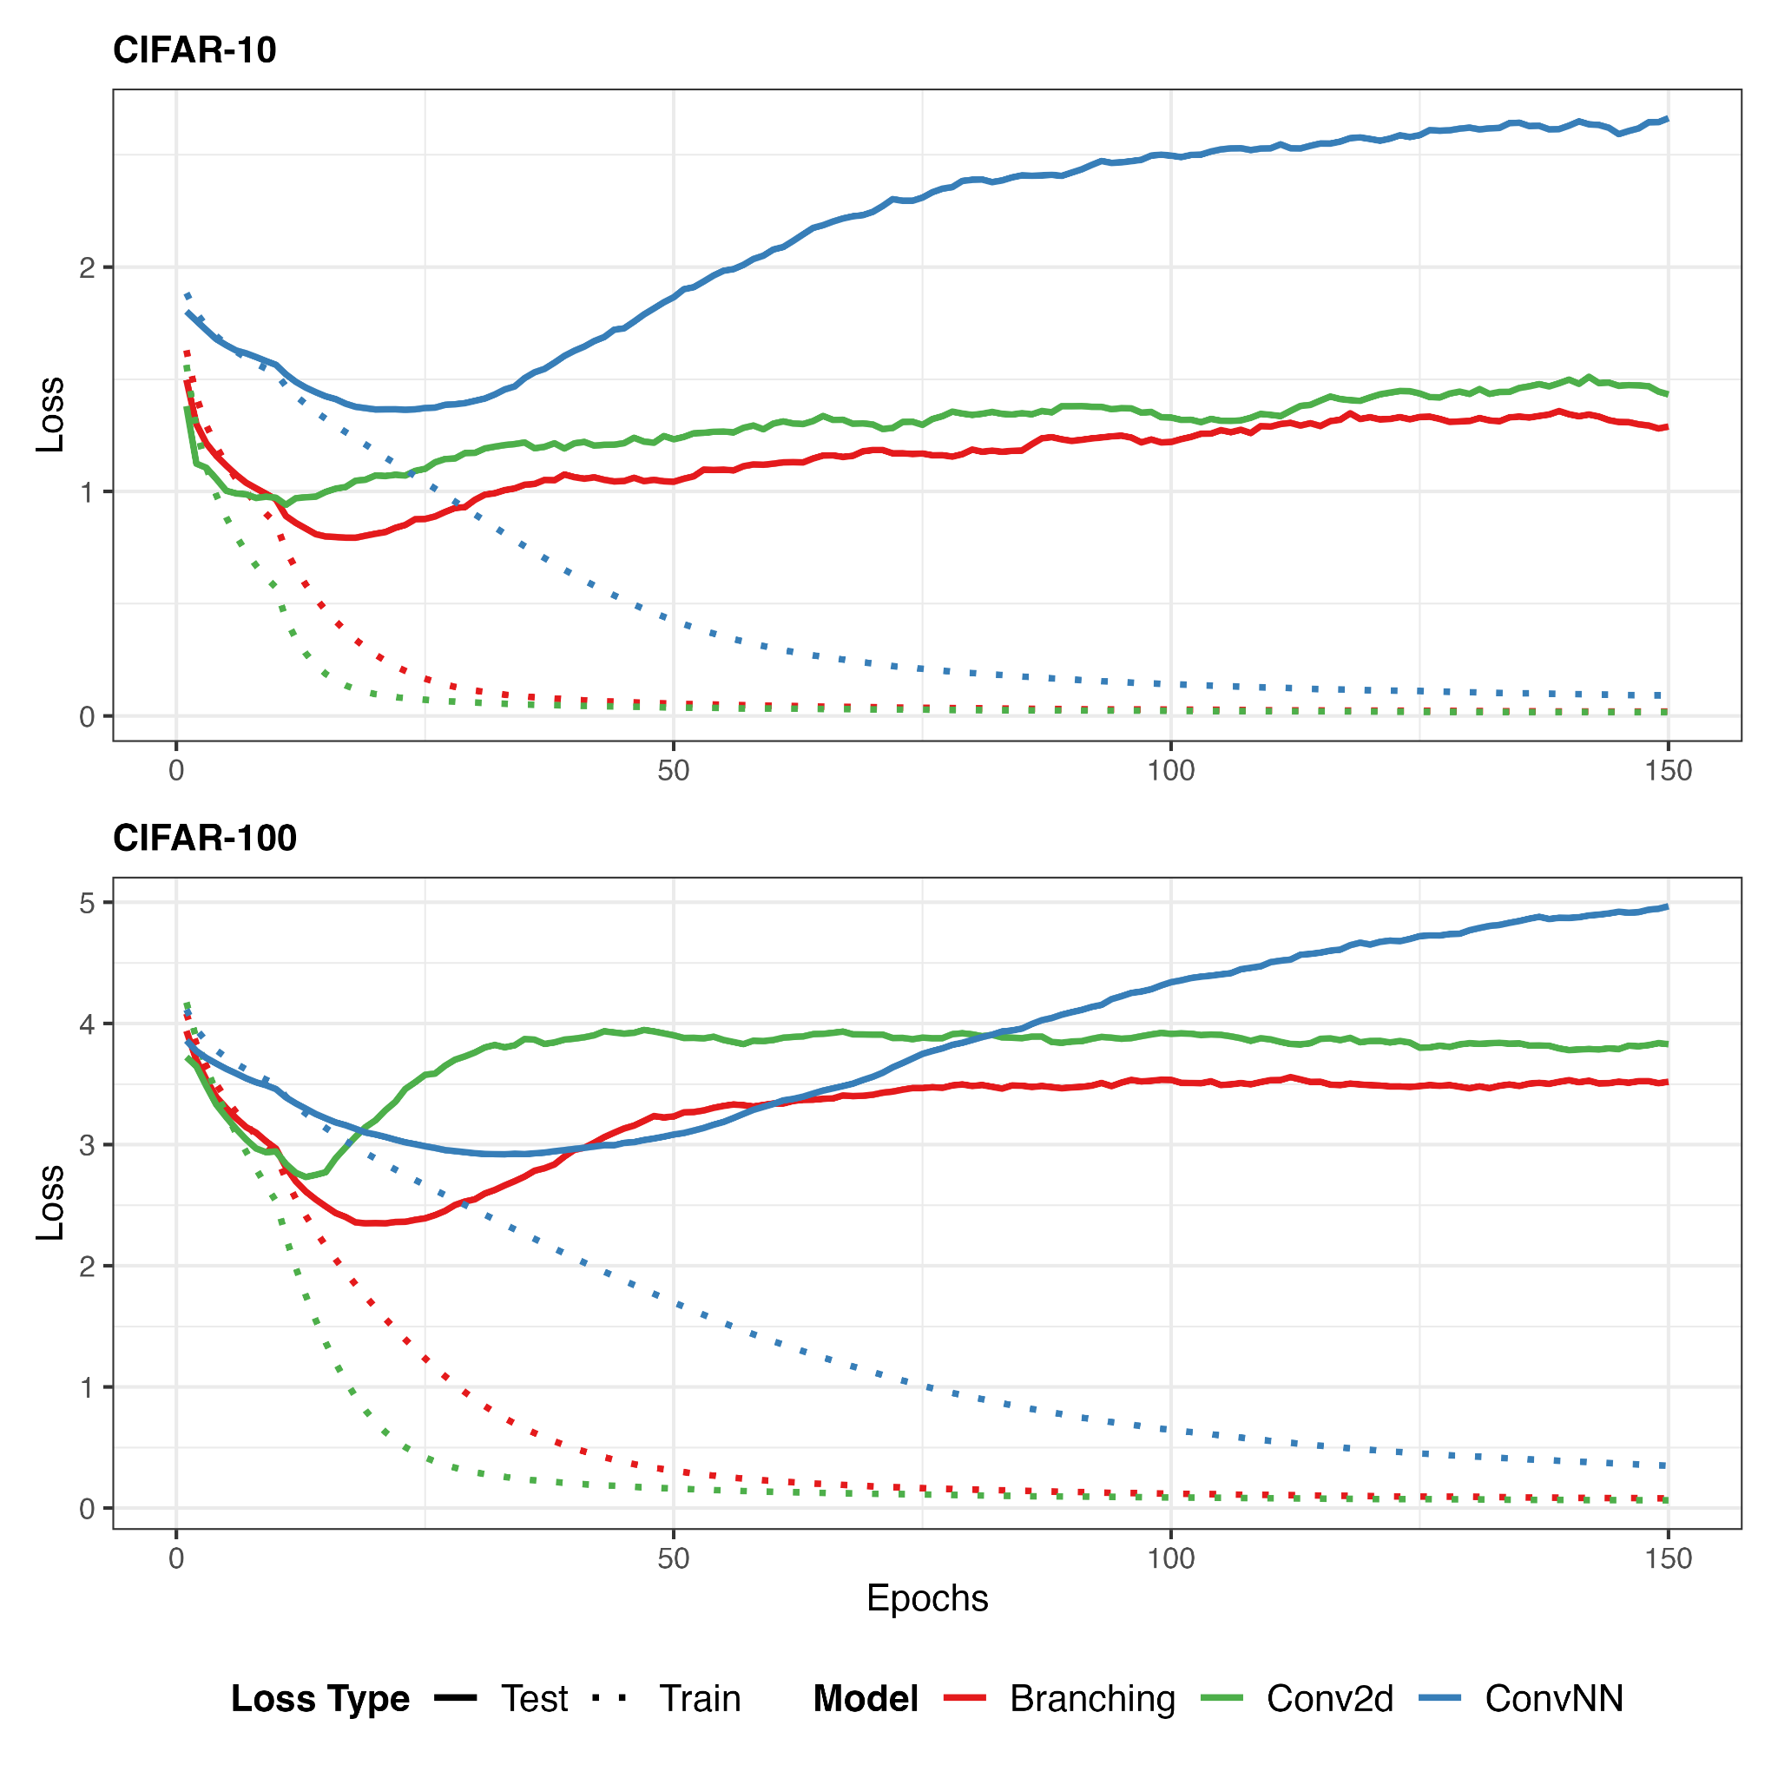
VGG-11 Results
Conv2D: Kernel Size = 3 (3x3)
ConvNN: K = 9
Mingi Kang mkang2@bowdoin.edu
Notes:
Remove slide, just explain shortly

Slide 15
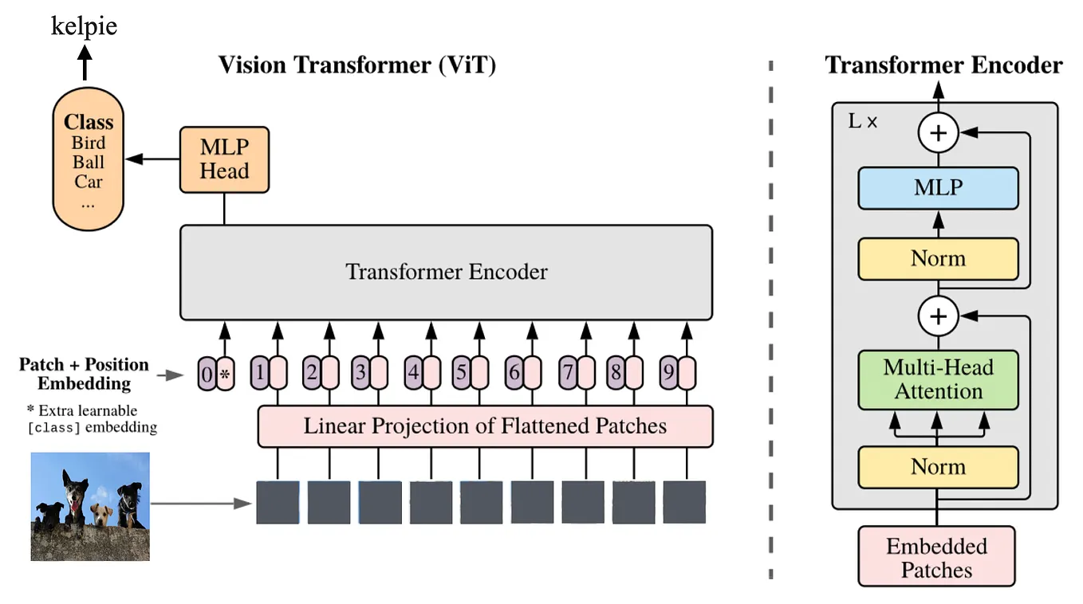
Vision Transformers
Vision Transformers (ViT) (Dosovitskiy et al., 2021)
Architecture Overview:
Images are divided into fixed-size patches (16x16)
Applied self-attention directly to image patches
Patches are linearly embedded and fed to Transformer encoder
Multi-Head attention captures global dependencies
Our Experiments:
Replace multi-head attention with ConvNN-Attention
https://medium.com/@RobuRishabh/vision-transformer-vit-39f627d04b2a

Slide 16
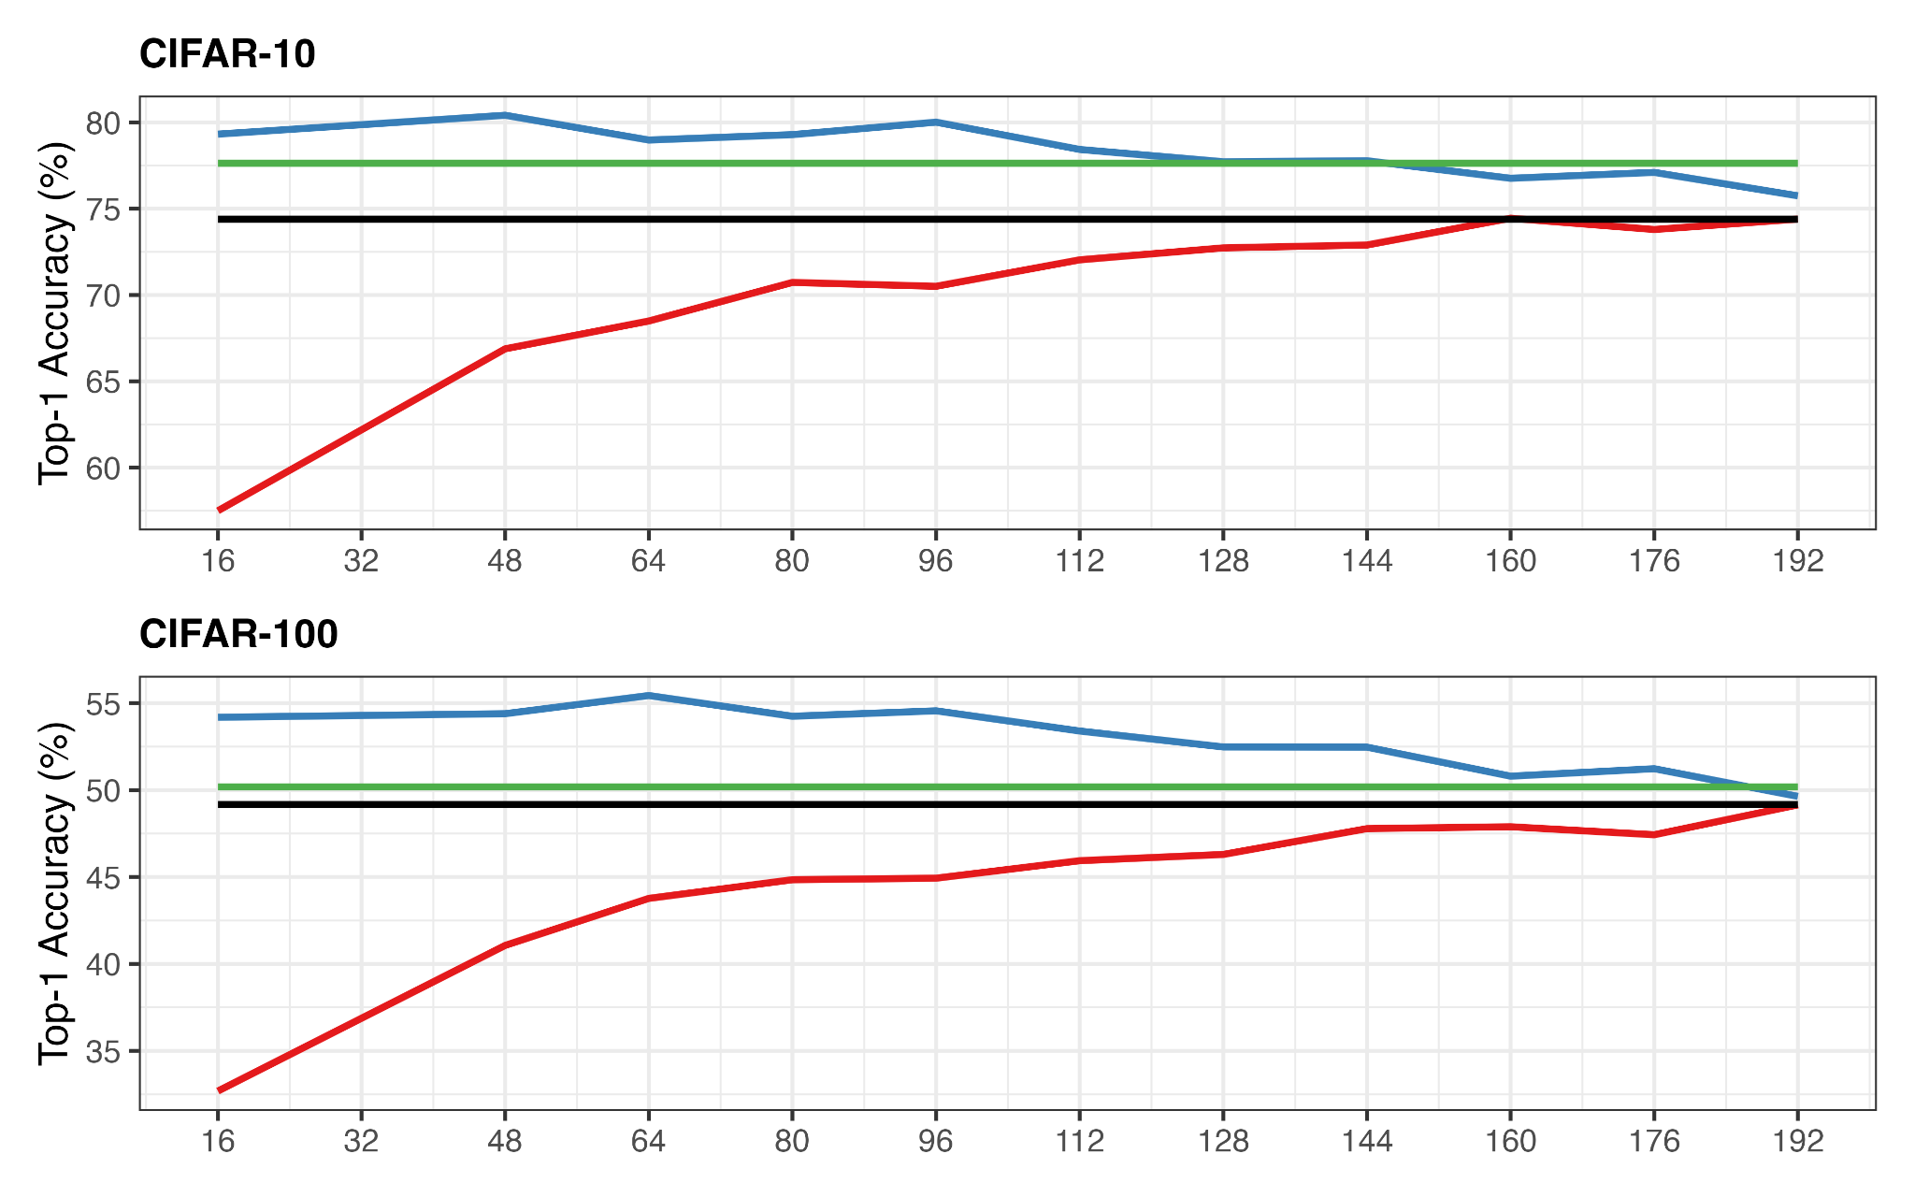
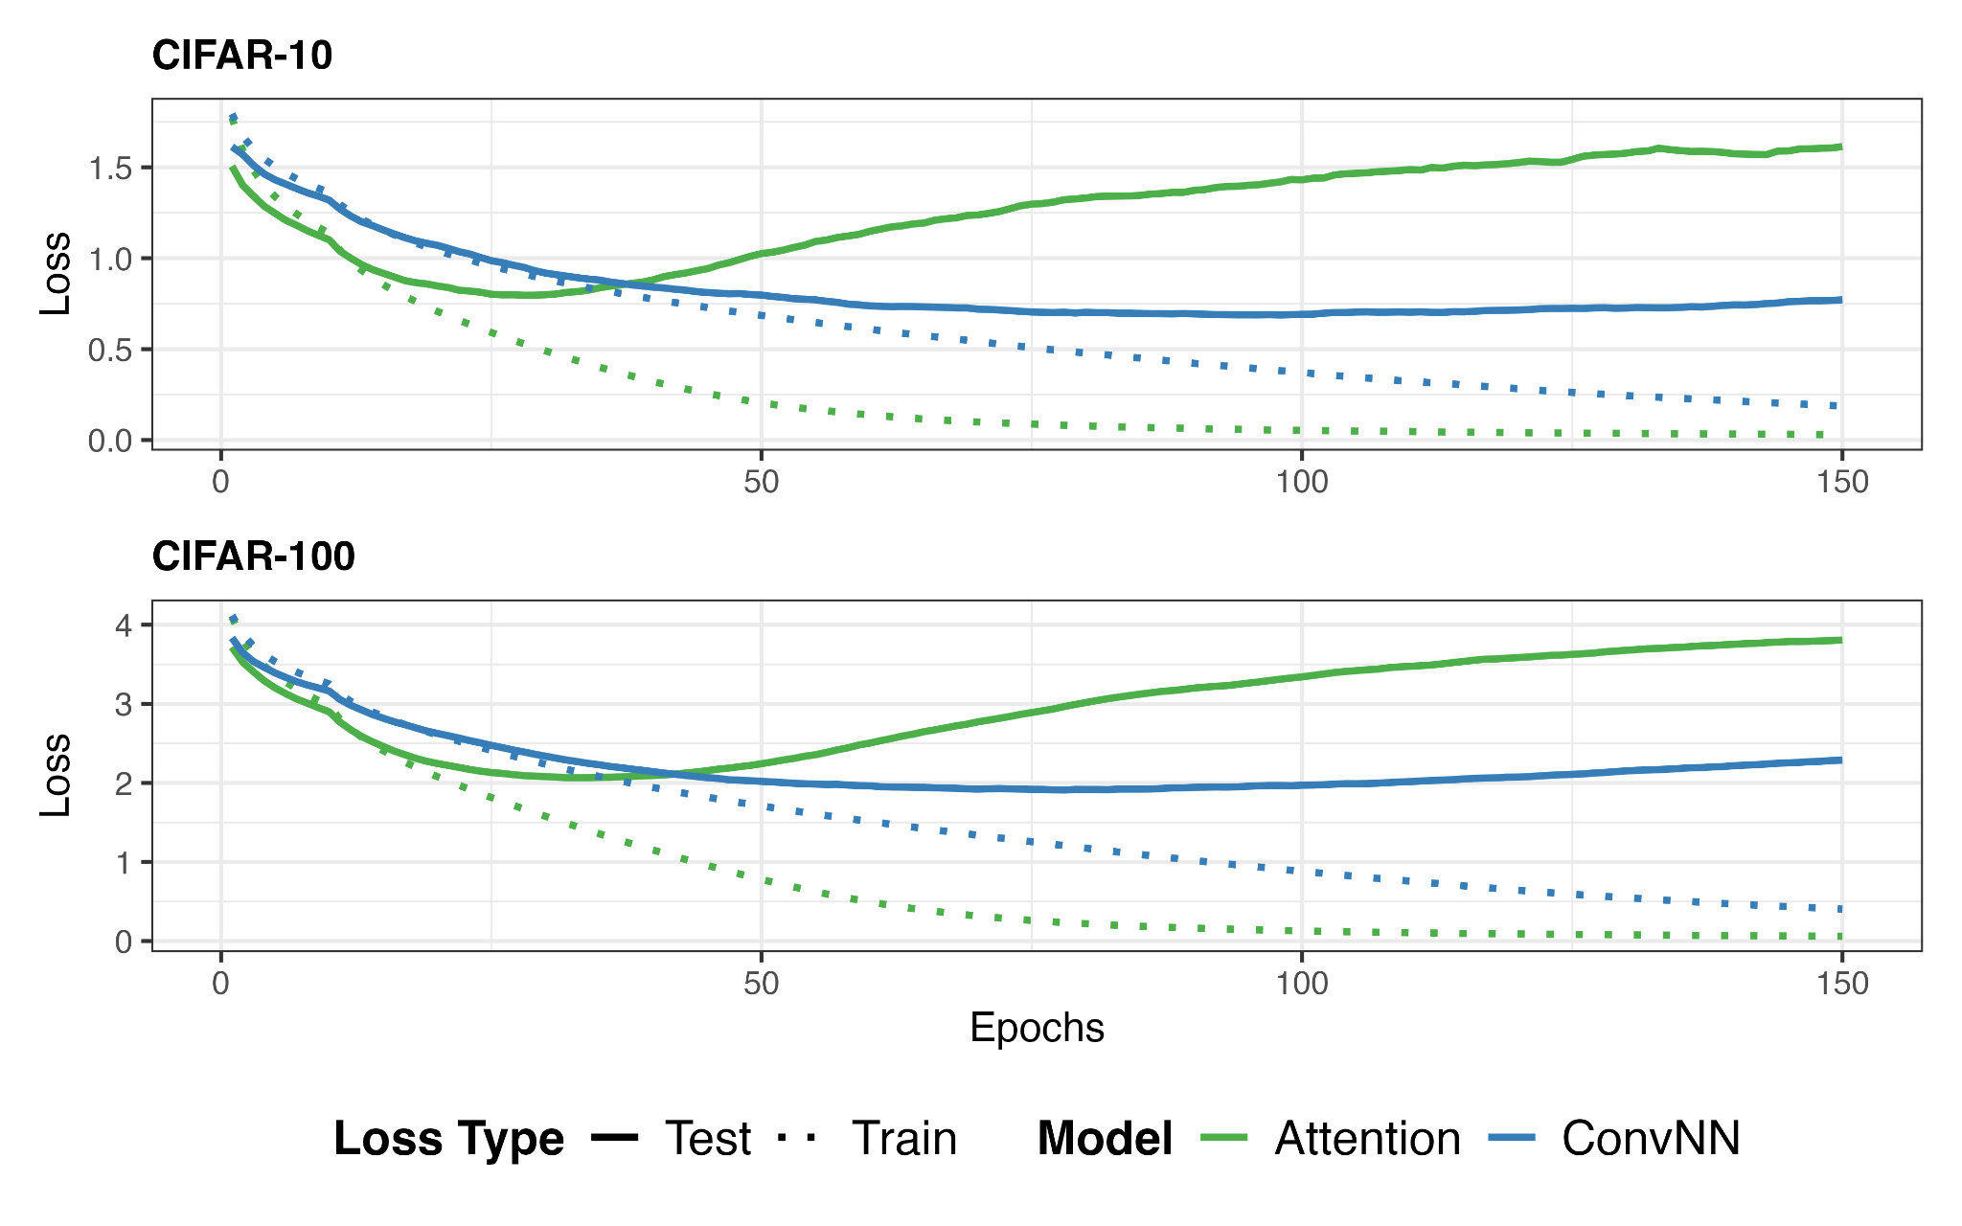
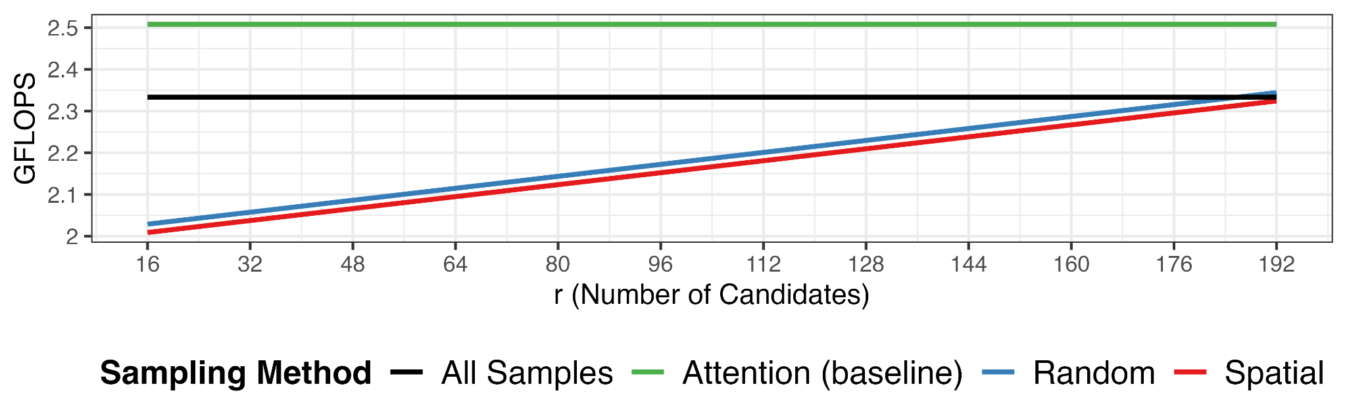
ViT-Tiny Results
ConvNN: K = 9
Random Sampling: r = r’ = 32
Mingi Kang mkang2@bowdoin.edu
Notes:
Remove slide, just explain shortly

Slide 17
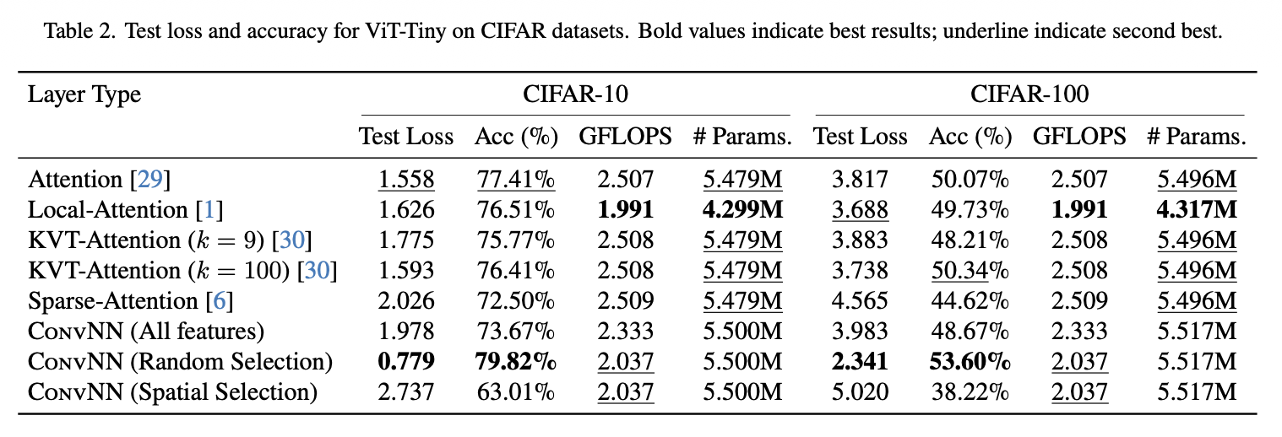
ViT-Tiny Results
ConvNN: K = 9
Sampling: r = r’ = 32
Mingi Kang mkang2@bowdoin.edu
Notes:
Remove slide, just explain shortly

Slide 18
Future Work
Architectural Analysis: Compare how CNN’s and Transformer’s architectural components contribute to feature learning.
Scaling Experiments: Extend experiments and evaluations to ImageNet-1K and other large-scale benchmarks.
Publication: Revise and resubmit based on conference feedback (reviews expected late January).
Theoretical Work: Develop mathematical proof of ConvNN’s generalizability framework.
Mingi Kang mkang2@bowdoin.edu

Slide 19

Access Paper:
https://arxiv.org/abs/2511.14137
Mingi Kang mkang2@bowdoin.edu

Slide 20
Thank You!
Mingi Kang mkang2@bowdoin.edu

